Slide 1
DATA 601 –Make and Git
Dr. Ergun Simsek

Slide 2
MAKE
Part I

Slide 3
Make
Make is a versatile tool which can run commands
Some examples
Compile source code into executable programs or libraries
Run scripts on data files to get summaries or plots
Parse and combine text files and plots to create paper
Make is designed so as to only update files when they need to be. It tracks the dependencies between files it creates and files used to create them.
Read
Output
Process

Slide 4
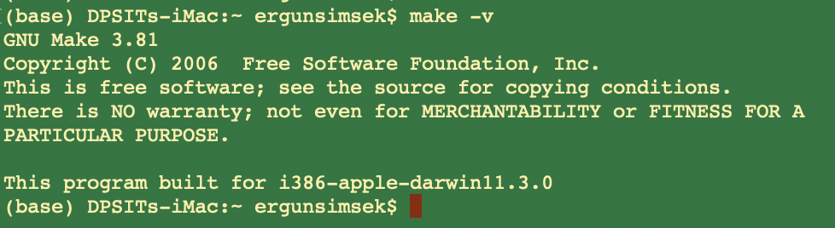
Setup
Make is already available in Unix machines
On Macs, make comes with Xcode
For Windows, I have no clue
https://github.com/swcarpentry/windows-installer
Open a terminal and check whether you have it
make -v

Slide 5
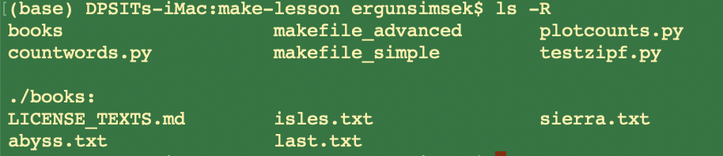
Example
Let’s look at our folder
We have 3 *.py codes
We have a subfolder called “books” which has some *.txt files

Slide 6
countwords.py
import sys
# bunch of functions
# bunch of functions
# …
# at the end, we have the following lines. EXAMINE!!
if __name__ == '__main__':
input_file = sys.argv[1]
output_file = sys.argv[2]
min_length = 1
if len(sys.argv) > 3:
min_length = int(sys.argv[3])
word_count(input_file, output_file, min_length)

Slide 7
testzipf.py
Warning
from countwords import load_word_counts
import sys
def top_two_word(counts):
"""
Given a list of (word, count, percentage) tuples,
return the top two word counts.
"""
limited_counts = counts[0:2]
count_data = [count for (_, count, _) in limited_counts]
return count_data
if __name__ == '__main__':
input_files = sys.argv[1:]
print("Book\tFirst\tSecond\tRatio")
for input_file in input_files:
counts = load_word_counts(input_file)
[first, second] = top_two_word(counts)
bookname = input_file[:-4]
print("%s\t%i\t%i\t%.2f" %(bookname, first, second, float(first)/second))

Slide 8
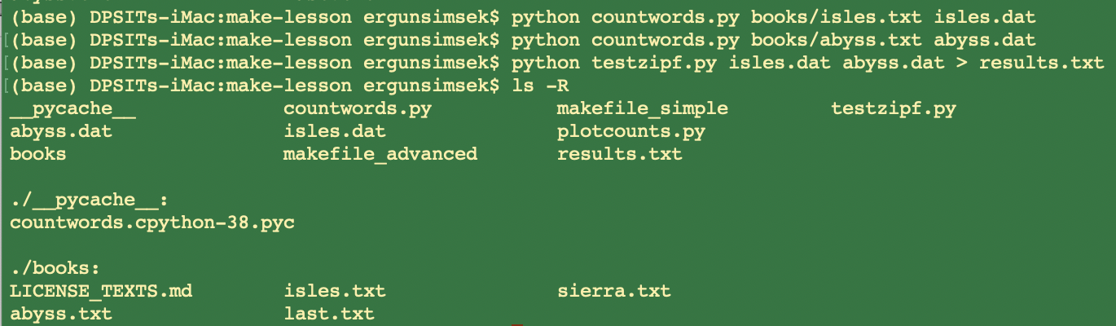
Example
The Python program “countwords.py” counts the frequency of each word in a text file.
We want to out the frequency of words in “x.txt” to a new data file “x.dat”
Then we want to use the “testzipf.py” to test the “Zipf’s Law” on the “x.dat”
In a terminal, we can
achieve this in 3 steps
WHAT IF YOUR TASK IS RUNNING THESE CODES FOR THOUSANDS OF BOOKS?
Notes:
Zipf’s Law: the frequency of any word is inversely proportional to its rank in the frequency table. Thus the most frequent word will occur approximately twice as often as the second most frequent word, three times as often as the third most frequent word, etc.

Slide 9
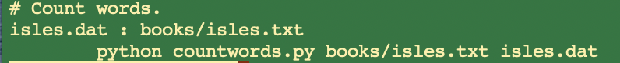
Example Cont.
We can create a Makefile to automate processing of the texts.
Let us create a new file called “makefile” (no extension) with the following content:
target and dependency are separated by :
“#” denotes a comment
dependency
target
ACTION
tab
(not 8 spaces)
dependency
target
To take action, simply enter “make” in the terminal

Slide 10
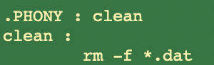
Phony Targets
Suppose we only care about the “results.txt”, hence we want to remove all our data files *.dat, when we are done with counting
We can introduce a new target “clean,” and associated cleaning rule, to the end of our Makefile.
Here, the target “clean” is “.PHONY” in the sense that it doesn’t refer to a name of file. it is just a name for a recipe to be executed when you make an explicit request.
-f: ignore non-existing files

Slide 11
$ make
python ../countwords.py ../books/abyss.txt abyss.dat
$ ls
abyss.dat isles.dat makefile
$ make clean
rm -f *.dat
$ ls
makefile
# input
# input
# input
# input

Slide 12
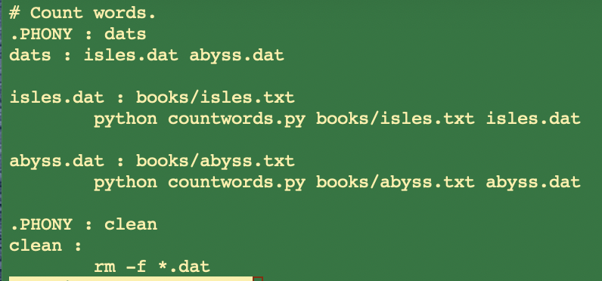
Multiple Targets
As the Makefile gets larger, there may be a variety of data file targets that we would like to be able to build all at once.
One way of doing this would be with a phony target “dats” which depends on all of the targets we want to build.
Let’s put the following at the beginning of the Makefile so that it is the default target.

Slide 13
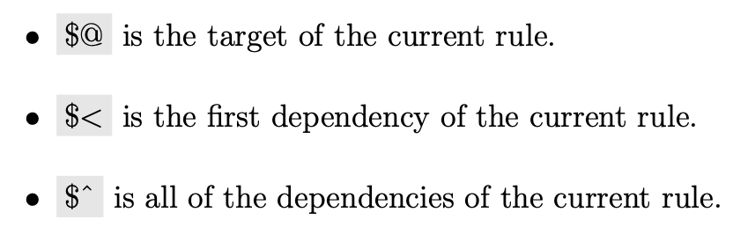
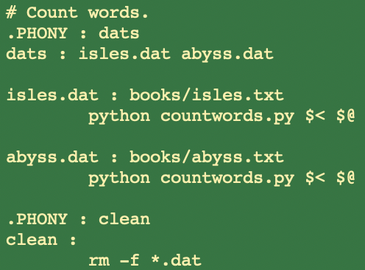
Automation (Step 1)
Automatic variables are reserved expressions for targets and dependencies to be used within rules.

Slide 14
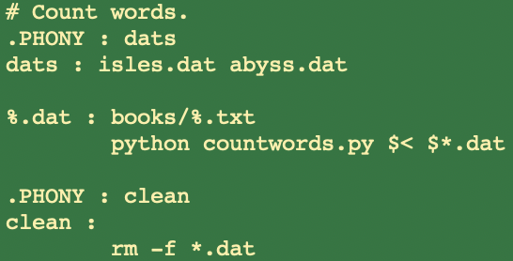
Automation (Step 2: Pattern Rules)
Our Makefile still has repeated content. Specifically, the rules for each data file are identical except for the book name.
We can replace these rules with a single pattern rule.
This rule specifies how to build any data file from a text file in the books directory:

Slide 15
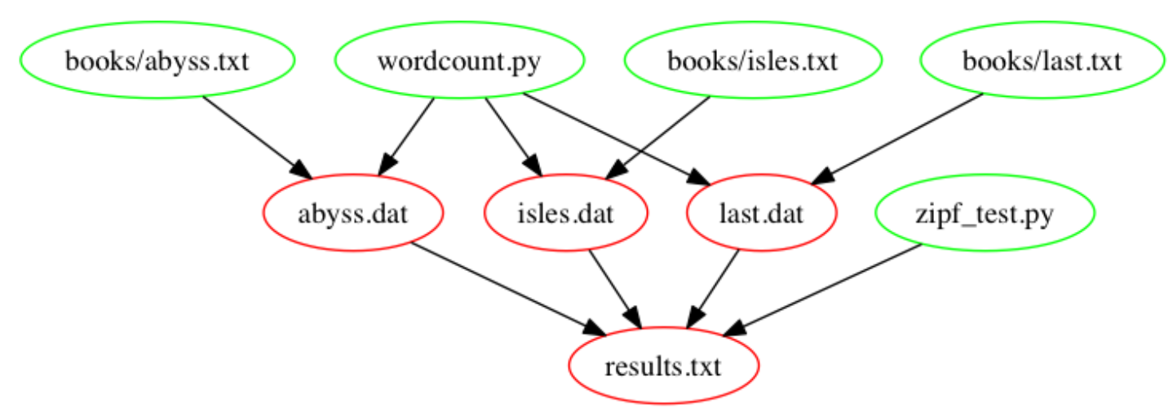
Process, Build Results, Clean the Mess!
countwords.py
testzipf.py

Slide 16
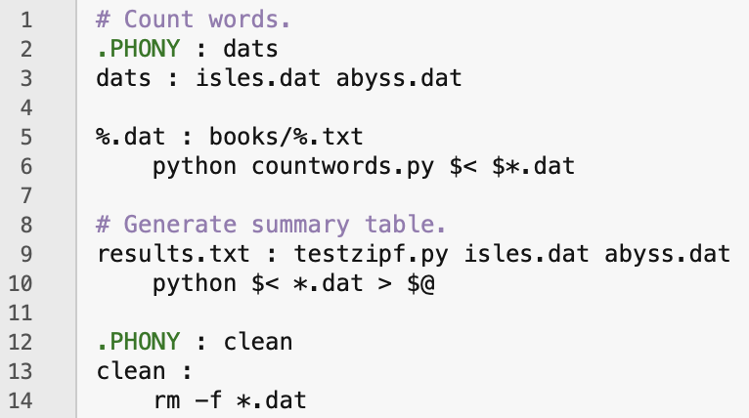
Make: Build Results

Slide 17
GIT
Part II

Slide 18
Git: main features
Track all your changes
Work along with others
Share work with others
With Git

Slide 19
Git is a distributed version-control system
You keep your files in a repository on your local machine.
You synchronize your repository with a repository on a server.
If you move from one machine to another, you can pick up the changes by synchronizing with the server.
If someone else on your team uploads some changes to your files, you can pick those up by synchronizing with the server.

Slide 20
Git is a distributed version-control system
Terminology: In git-speak, a “version” is called a “commit.”
Git keeps track of the history of your commits, so you can go back and look at earlier versions, or just give up on the current version and go back some earlier version.

Slide 21
A simple model of git
Most git documentation gets into details very quickly.
Here’s a very simple model of what’s going on in git.

Slide 22
Your files
my-project
docs
README.md
README.html
src
main.py
cleandata.py
EDA.py
ML_models.py
Here are your files, sitting in a directory called my-project

Slide 23
Your files in your git repository
.git
my-project
docs
README.md
README.html
src
main.py
cleandata.py
EDA.py
ML_models.py
When you have a git repository, you have an additional directory called .git, which points at a mini-filesystem.
This file system keeps all your data, plus the bells and whistles that git needs to do its job.
All this sits on your local machine.
Here are your files, sitting in a directory called my-project

Slide 24
The git client
.git
my-project
docs
README.md
README.html
src
main.py
cleandata.py
EDA.py
ML_models.py
This mini-filesystem is highly optimized and very complicated. Don’t try to read it directly.
The job of the git client is to manage this for you.

Slide 25
Your workflow (part 1)
You edit your local files directly.
You can edit, add files, delete files, etc., using whatever tools you like.
This doesn’t change the mini-filesystem, so now your mini-filesystem is behind.

Slide 26
A Commit
.git
my-project
docs
README.md
README.html
src
main.py
cleandata.py
EDA.py
ML_models.py
commit
When you do a “commit”, you record all your local changes into the mini-filesystem.
The mini-filesystem is “append-only”. Nothing is ever over-written there, so everything you ever commit can be recovered.

Slide 27
Synchronizing with the server (1)
your local machine
a server, somewhere on the internet, eg. github.com
.git
push
my-project
docs
README.md
README.html
src
main.py
cleandata.py
EDA.py
ML_models.py
At the end of each work session, you need to save your changes on the server. This is called a “push”.
Now all your data is backed up.
You can retrieve it, on your machine or some other machine.
Your teammates can retrieve it as well

Slide 28
Synchronizing with the server (2)
your local machine
a server, somewhere on the internet, eg. github.com
.git
pull
my-project
docs
README.md
README.html
src
main.py
cleandata.py
EDA.py
ML_models.py
To retrieve your data from the server, you do a “pull”. A “pull” takes the data from the server and puts it both in your local mini-fs and in your ordinary files.
If your local file has changed, git will merge the changes if possible. If it can’t figure out how to the merge, you will get an error message. We’ll talk about this some more a little later in this lesson.
pull

Slide 29
The whole picture
your local machine
pull
a server, somewhere on the internet, eg. github.com
.git
my-project
docs
README.md
README.html
src
main.py
cleandata.py
EDA.py
ML_models.py
push
commit
pull

Slide 30
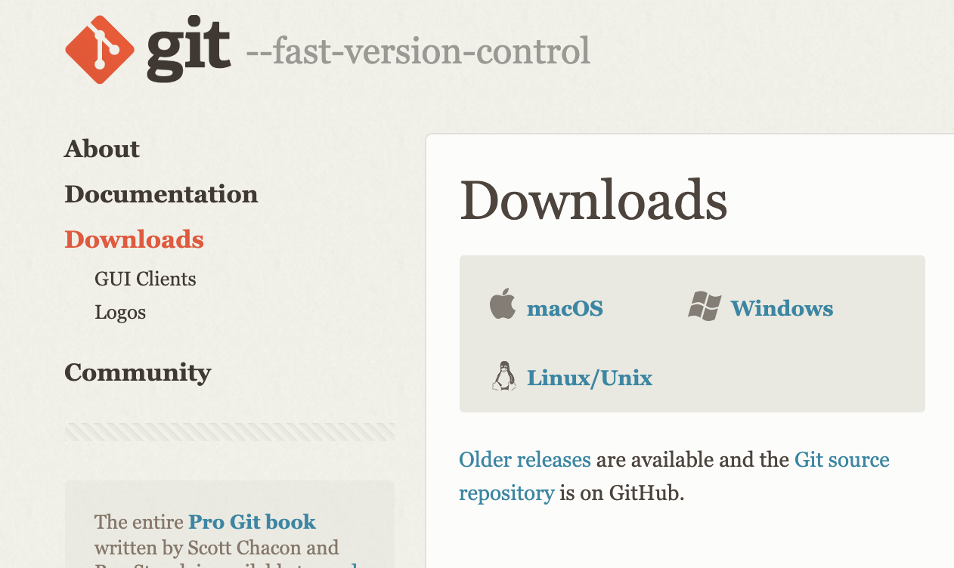
Installing Git
https://git-scm.com/downloads
You can check whether you already have git
You better get the latest version. 1. install homebrew, 2. brew install git
Notes:
GitHub requires getting a token
https://ginnyfahs.medium.com/github-error-authentication-failed-from-command-line-3a545bfd0ca8

Slide 31
Step-1: Basic Configuration
Open a terminal
Tell git your name and email:
git config --global user.name “Your Full Name”
git config --global user.email your_uni@umbc.edu
You can set the default editor, e.g. nano or pico or whatever you have/like
git config --global core.editor nano
git config --global content.editor "pico -w"
You can set main as the default branch name do:
git config --global init.defaultBranch main
You only have to do this once. You can make changes later, if you want
To check the current configuration
git config --list

Slide 32
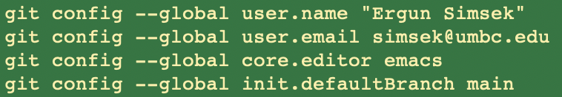
Example
Getting Help
git help <verb>
git <verb> --help
man git-<verb>
For example
git help config

Slide 33
Getting a Git Repository
You typically obtain a Git repository in one of two ways:
You can take a local directory that is currently not under version control, and turn it into a Git repository, or
You can clone an existing Git repository from elsewhere.
In either case, you end up with a Git repository on your local machine, ready for work.
For the first approach, we’ll use
git init - this initiates a git repository in the current folder
May take a while. Check the directory with ls –a
But let’s see the 2nd approach

Slide 34
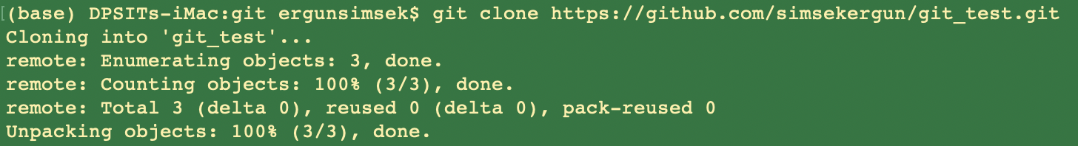
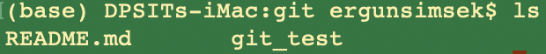
GitHub
In order to have an example, I created an empty repo on my github repo
Even though it is empty, let’s clone it to get a copy
https://github.com/simsekergun/git_test
git clone https://github.com/simsekergun/git_test.git

Slide 35
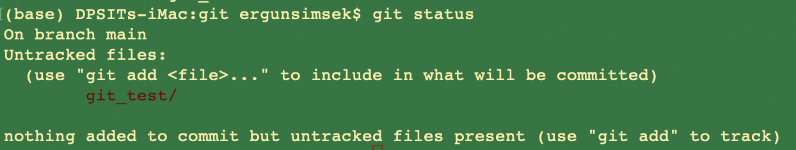
Checking the Status of Your Files
The main tool you use to determine which files are in which state is the git status command. If you run this command directly after a clone, you should see something like this:
This means you have a clean working directory; in other words, none of your tracked files are modified.

Slide 36
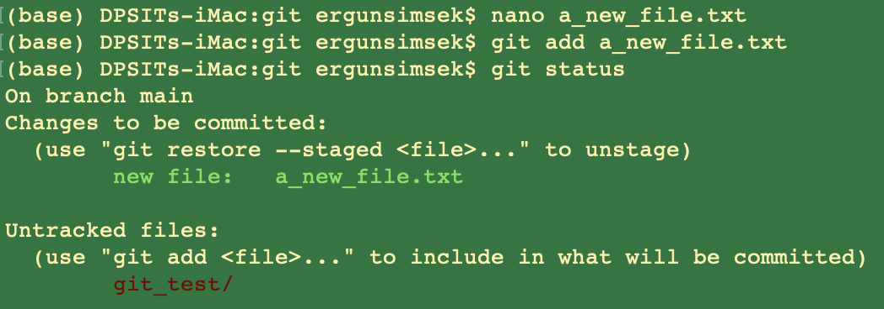
Let’s make a change
Let’s create a new file called “a_new_file.txt”
Then add it to the project

Slide 37
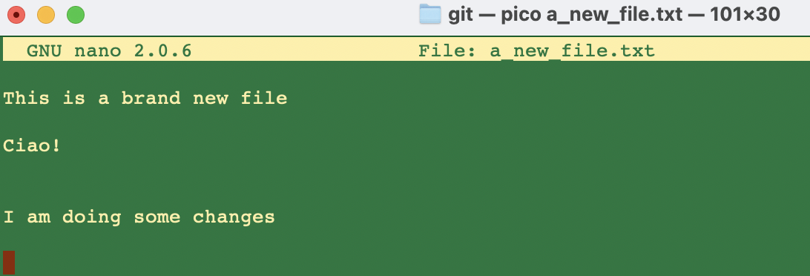
Let’s make some changes

Slide 38
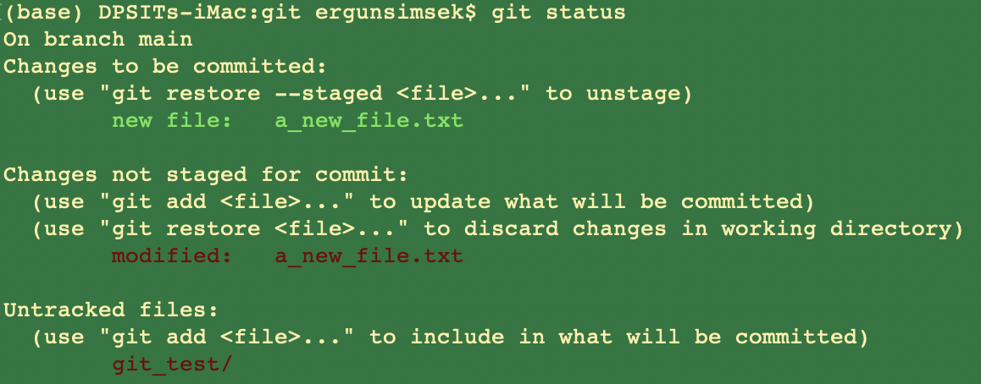
Let’s see what happens to the status

Slide 39
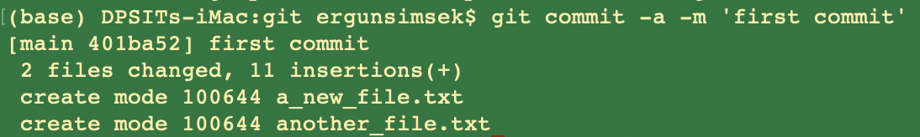
Let’s Commit
git commit -a -m 'first commit'
your personal note here

Slide 40
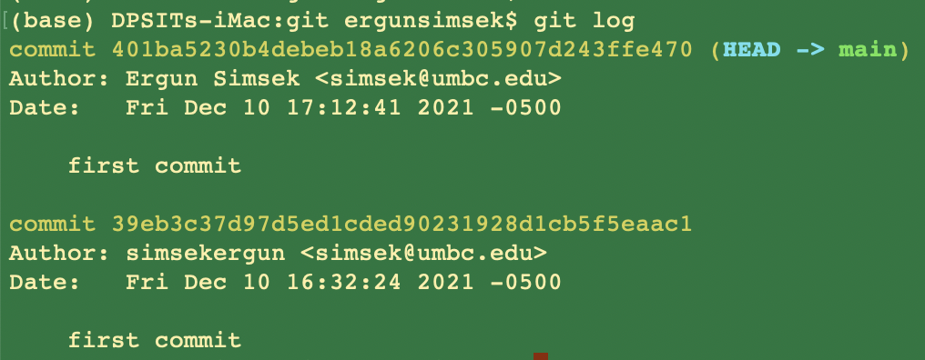
Viewing the Commit History

Slide 41
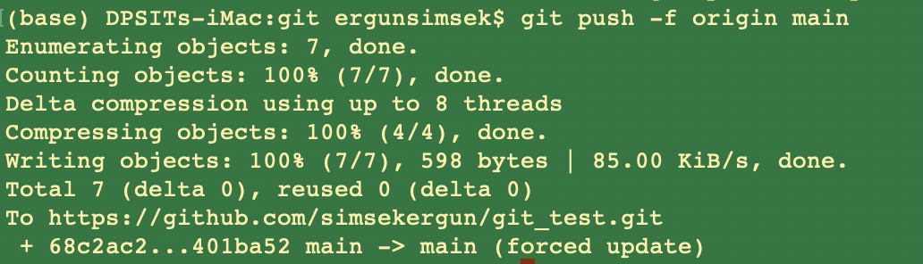
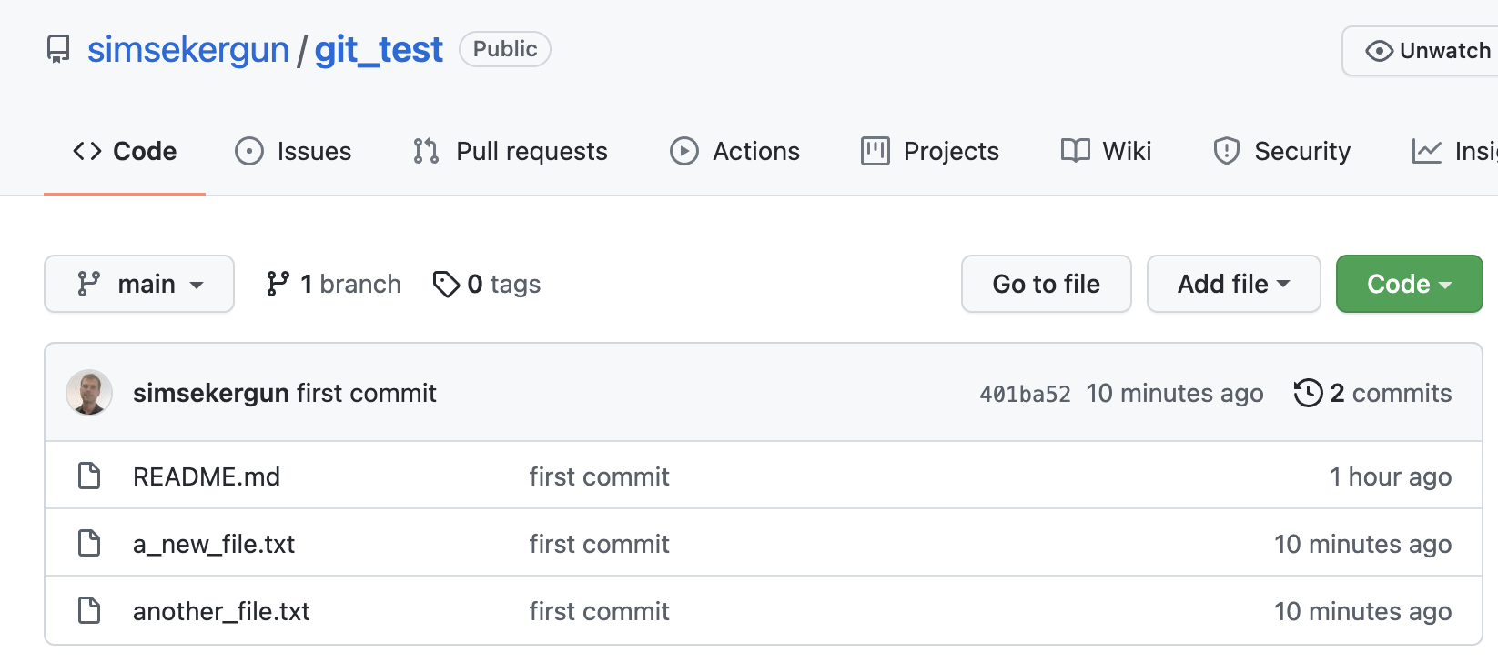
Pushing to Your Remotes
Voilaaaaa!

Slide 42
Git Workflow: New Project
git init <folder_name> (as in tutorial part one)
Local
computer
git add <file_name>
git commit -m “messages”
Github.com

Slide 43
Your workflow over multiple sessions
You pull the latest version of your work from the server
You, maybe on another computer
You
You
pull
pull
pull
edit
edit
edit
commit
commit
commit
edit
server
edit
server
edit
commit
commit
commit
edit
edit
edit
commit
commit
commit
push
push
push
You push your work to the server
You update your-ID-log.txt at the end of each session

Slide 44
Oh no! I’ve got a git conflict
If you update your work before you pull, git will try to merge the changes when you do pull.
If git can’t figure out how to do the merge, it will go into a special mode in which it expects you to resolve the conflicts.
When you have the files the way you want them, you can commit them and continue working. Here’s a guide https://docs.github.com/en/pull-requests/collaborating-with-pull-requests/addressing-merge-conflicts/resolving-a-merge-conflict-using-the-command-line

Slide 45
Branches
Branches are used to develop features isolated from each other.
The master branch is the "default" branch when you create a repository.
Use other branches for development and merge them back to the master branch upon completion.

Slide 46
Branching
create a new branch named "feature_x" and switch to it using
git checkout -b feature_x
switch back to master
git checkout master
and delete the branch again
git branch -d feature_x
a branch is not available to others unless you push the branch to your remote repos
git push origin <branch>
to merge another branch into your active branch (e.g. master), use
git merge <branch>

Slide 47
Other ways to use git and github
There are lots of possible ways to use git and github.
But for core data science courses, you should be able to get by just fine with just a single master branch.
There are many resources, interactive git tutorials on the web.
http://book.git-scm.com/book/en/v2
http://think-like-a-git.net/
Please google it (e.g. git for data science, best git tutorials, etc)
Review as many as possible
And try to implement on your own
KISS principle: “Keep It Simple, Stupid!”

